Slide 1
Elastic Stack demo
Hajar Abu- Rmeileh
Software Engineering Class
Supervisor :Dr. Wesam Herbawi
Jun 2023

Slide 2




Elastic Stack
Centralized logging
ELK

Slide 3
Elastic Stack
is a NoSQL database that is based on the Lucene search engine.
is a log pipeline tool that accepts inputs from various sources, and exports the data to various targets.
is a visualization UI layer that works on top of Elasticsearch.

Slide 4
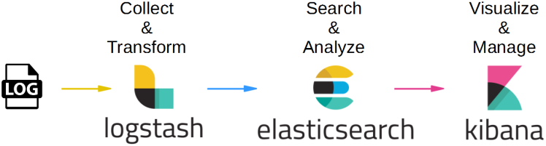
Elastic Stack
These three projects are used together for log analysis in various environments.
- Logstash collects and parses logs,
- Elastic search indexes and store this information.
- Kibana provides a UI layer that provide actionable insights.

Slide 5
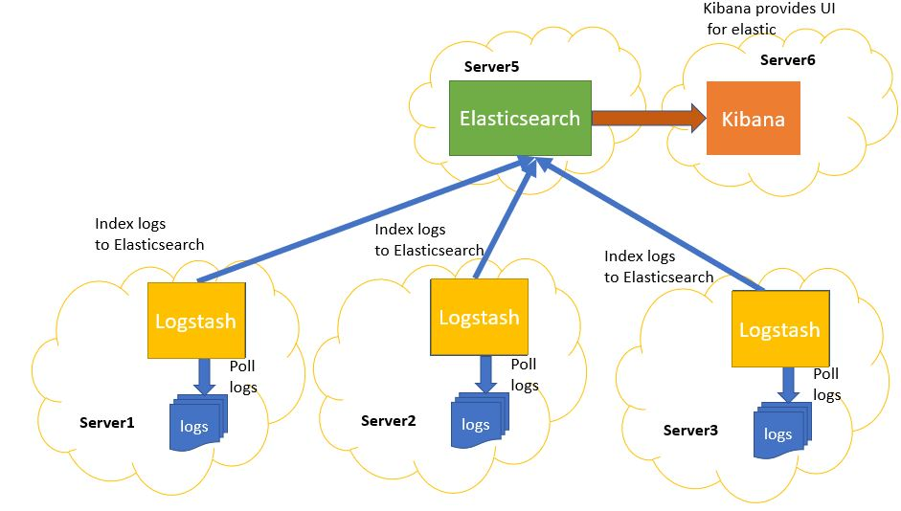
Elastic Stack
Pull logs
Pull logs
Pull logs

Slide 6
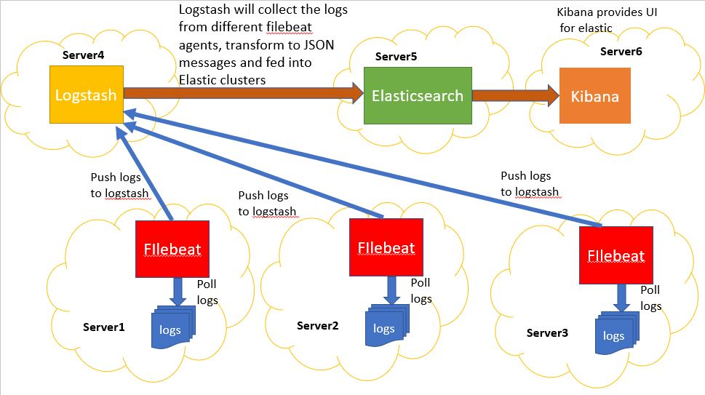
Elastic Stack

Slide 7

Elastic Stack
a lightweight shipper for forwarding and centralizing log data.

Slide 8




Elastic Stack
https://github.com/Java-Techie-jt/elk-stack-logging-example

Slide 9
Elastic Stack
Download elastic search
https://www.elastic.co/downloads/elasticsearch
Open elasticsearch.yml
# Enable security features
xpack.security.enabled: false
Run elasticsearch.bat in bin files
elasticsearch.bat
localhost:9200

Slide 10

Elastic Stack
Download Kibana
https://www.elastic.co/downloads/kibana
Run kibana.bat in bin files
kibana.bat
localhost:5601

Slide 11
Elastic Stack
Download logstash
https://www.elastic.co/downloads/logstash

Slide 12
Elastic Stack
Download filebeat
https://www.elastic.co/downloads/beats/filebeat

Slide 13

Elastic Stack
cmd
cmd
Run in bin files:
logstash.bat -e "input { stdin { } } output { stdout {} }"
https://www.elastic.co/guide/en/logstash/current/first-event.html

Slide 14


Elastic Stack
Create in config files:
cmd-elastic.conf
input {
stdin {
}
}
output {
elasticsearch {
hosts => ["http://localhost:9200"]
index => "hellodb"
}
}
Run in bin files:
logstash -f ./config/cmd-elastic.conf --config.reload.automatic

Slide 15

Elastic Stack
Delete registry folder
C:\Users\admin\Downloads\filebeat-8.8.0-windows-x86_64\data\registry
Create in filebeat-8.8.0-windows-x86_64:
cmd
Log file
filebeat-cmd.yml
filebeat.inputs:
- type: log
paths:
- C:/Users/admin/Downloads/logstash-tutorial-dataset.txt
output.console:
pretty: true
Run in filebeat-8.8.0-windows-x86_64:
filebeat -e -c filebeat-cmd.yml -d "publish"

Slide 16
Elastic Stack
filebeat-logstash.yml
first-pipeline.conf
input {
beats {
port => "5044"
}
}
# The filter part of this file is commented out to indicate that it is
# optional.
# filter {
#
# }
output {
stdout {}
}
filebeat.inputs:
- type: log
paths:
- C:/Users/admin/Downloads/logstash-tutorial-dataset.txt
output.logstash:
hosts: ["localhost:5044"]

Slide 17
Elastic Stack
Delete registry folder
C:\Users\admin\Downloads\filebeat-8.8.0-windows-x86_64\data\registry
2
1
Filebeat-logstash.yml
first-pipeline.conf
filebeat -e -c filebeat-logstash.yml -d "publish"
logstash -f ./config/first-pipeline.conf --config.reload.automatic
https://www.elastic.co/guide/en/logstash/current/advanced-pipeline.html

Slide 18
Elastic Stack
Run:
1. elasticsearch
2. Kibana
3. Logstash
4. filebeat
Delete registry folder
C:\Users\admin\Downloads\filebeat-8.8.0-windows-x86_64\data\registry

Slide 19
Elastic Stack
Filebeat-logstash.yml
logstash-elastic.conf
input {
beats {
port => "5044"
}
}
output {
stdout { codec => rubydebug }
elasticsearch {
hosts => ["http://localhost:9200"]
index => "logdb"
}
}
logstash -f ./config/logstash-elastic.conf --config.reload.automatic
filebeat -e -c filebeat-logstash.yml -d "publish"

Slide 20
Elastic Stack
https://github.com/Java-Techie-jt/elk-stack-logging-example
filebeat -e -c filebeat-logstash-real.yml -d "publish"
logstash -f ./config/logstash-elastic.conf --config.reload.automatic

Slide 21
Elastic Stack
http://localhost:9200/_cat/indices

Slide 22
Thanks for listening
Hajar Abu- Rmeileh
Software Engineering Class
Supervisor :Dr. Wesam Herbawi
Jun 2023

